Slide 1
CRM Best Practice for SMEs
SMEs Trading Ltd

Slide 2
Contents
Introduction to CRM
Approaches to CRM
Delivering a CRM Initiative
Selecting CRM Technology
Appendix

Slide 3
What is CRM?
It means many things to many people: -
Contact management
Sales force automation
Campaigns
Lead management
Marketing
Promotions
Partner management
And so on…..

Slide 4
What is CRM?
Maximising a customer’s value through differential management of the customer relationship. This is achieved by:
Segmenting customers based on their profitability
Understanding the behaviour, wants and needs of each customer segment
Deciding how to
invest in profitable relationships
manage costs to improve margins
divest unprofitable customers
Delivering appropriate offerings to achieve the above goals

Slide 5
Why CRM?
Totally satisfied customers are 6 times more likely to repurchase than satisfied customers
A totally satisfied customer will tell 5 people about their experience, while each dissatisfied customer will tell 9
Reducing defections by 5% can boost profits by 25%
The average company loses 50% of its customers over a 5 year period
Companies typically spend 5 times more on customer acquisition than on retention
Source: NetProfit

Slide 6
CRM integrates processes across the customer lifecycle
Marketing
Sales Service & Support
Attract
Interact
Convert
Fulfill
Service &
Support
Retain
Feedback
You may choose to address only parts of the lifecycle

Slide 7
What are the benefits of successful CRM?
Increased propensity to purchase
Attract new customer through reputation
More willing to forgive future mistakes
Increased spend on current offerings
Cross-sell of new offerings
Up-sell of new offerings
More streamlined processes
Increased customer self-service
Reduced number of unprofitable customers

Slide 8
CRM Technology is an enabler
CRM can be delivered WITHOUT significant technology investment
CRM is NOT the implementation of CRM software (such as Siebel, Microsoft CRM or Super Office)
CRM software does not manage customer relationships FOR YOU
However:
CRM processes are often be best SUPPORTED by effective use of CRM software

Slide 9
CRM initiatives are believed to fail more often than they succeed
Annual Global CRM spending:
$ 3.5 billion per year on CRM software alone (Giga Group)
Implementation, Training and Maintenance can be 3 to 5 times higher (McKinsey and Co.)
Current failure rates:
55 to 70% of CRM projects do not produce results (Gartner Group, CGE&Y)
Close to 20% of CRM projects actually have a detrimental effect (Wharton Business School)

Slide 10
There are five main reasons why CRM initiatives fail
1. Implementing CRM technology before creating a customer acquisition and retention strategy |  | Mistaking CRM software for a customer strategy and therefore: allowing software vendors to drive your approach to customer management or retro-fitting a customer strategy to match a software purchase
2. Implementing CRM technology before creating a customer-focused organisation |  | 87% of CRM initiatives fail due to insufficient change management restructuring departmental, product or geographic structures re-engineering customer facing and backend processes redesigning roles, performance measures, compensation and training
Source: Harvard Business Review

Slide 11
There are five main reasons why CRM initiatives fail (continued)
3. Assuming more CRM technology is better |  | The larger the scope of the CRM software implementation, the: harder it is to deliver more likely it is to miss deadlines and overrun on time and cost more likely it is to be terminated
4. Stalking, not wooing customers (inappropriate communication method, frequency or content) 5. Data, data….. |  | Just because you can contact a customer does not mean that you should: understand which customers want a relationship with you contact them in ways that they value Data cleansing, and consolidation is not taken seriously Personal islands must be eliminated
Source: Harvard Business Review

Slide 12
CRM processes must be in place before technology is implemented
Provide value for customers |  | The core focus of CRM should be improve the value delivered to customers by continuously sensing and responding to customer / market dynamics
Ensure strong project governance |  | Leadership should provide commitment, communication of the need for change and urgency Project must be business lead and driven at all levels Formal “Change Management” can help ensure that change is supported and endures
Align organisation |  | Configure the company for success by optimising structure, processes and incentives
Implement CRM Technology |  | Modular implementation using prototyping can help ensure that the design meets the ever-changing organisational and market needs

Slide 13
Contents
Introduction to CRM
Approaches to CRM
Delivering a CRM Initiative
Selecting CRM Technology
Appendix

Slide 14
Industry research has identified three distinct approaches to CRM
1. Market-driven |  | The core focus of CRM for the company is improving the value delivered to customers The company continuously senses and responds to customer / market dynamics
2. Inner-directed |  | The core focus of CRM is to improve the internal operational capability of the company High failure rate as the company looks to improve internal metrics and solve internal problems rather than providing actual value to customers
3. Defensive approach |  | The core focus of CRM is to to deny advantage to a competitor The company continuously looks to react to competitors to maintain the status quo
Approach 1. is typically seen to be more successful
Source: Wharton Business School

Slide 15
Properly managed CRM does produce results
Source: Wharton Business School

Slide 16
Successful CRM focuses on four types of customer offering
Examples:
Placing orders
Order tracking
Frequent
Infrequent
 | Core | Extended
Primary
Offerings
Value-added
Offerings
Frequency
Problem Resolution
Offerings
New
Offerings
Examples:
Billing query
Pricing
Source: SBI
Differentiator

Slide 17
The whole organisation must be aligned to CRM
Making customer retention a priority for all employees
Having a wide remit to satisfy customers
Allowing differential treatment of customers
Organisational
Orientation
Providing information about relationships
Covering all customer ‘touch-points’
Sharing this across the organization
CRM
Improvement
Information
Components
Providing appropriate organizational structure
Designing processes for personalizing offerings
Providing incentives for building relationships
Processes &
Incentives
Source: Wharton Business School

Slide 18
Processes and Incentives are the most important
Has a significant effect at the top end of the scale – sets leaders apart
Organisational
Orientation
Necessary but on its own contributes little to a superior capability
CRM
Improvement
Information
Components
Note - this holds in a wide range of market conditions:
B2B or B2C
Large or small market size
Fast or slow growing market
Extremely or moderately competitive
Most influential component
Processes &
Incentives
Source: Wharton Business School

Slide 19
Contents
Introduction to CRM
Approaches to CRM
Delivering a CRM Initiative
Selecting CRM Technology
Appendix

Slide 20
CRM best practice approach
Governance
Understand
Market
Align
Organisation
Implement
CRM Technology
Time

Slide 21
Governance: CRM Governance, is vital for delivering success
Commitment
Understanding the need for change
Sense of Urgency
Business and customer driven project team with clearly assigned roles and responsibilities
Timetable and Milestones
Key Performance Indicators (KPIs)
Communication
Training
Supporting resources
Source: SBI

Slide 22
Governance: Leadership
Commitment |  | Leadership commitment shows that the company is serious about the initiative Leadership involvement to resolve the various complex challenges that will be encountered
Understanding and communication of the need for change |  | Company-wide understanding of will: ensure that initiative gets the support that it needs help prevent ‘turf-wars’ that often occur due to the CRM initiatives crossing departmental , functional, business unit and/or geographical boundaries
Sense of urgency |  | Provides a reason to change now Will help identify non-technical quick-wins that can be implemented immediately
Source: Wharton Business School

Slide 23
Governance: Project Management
Business and customer driven project team (from all levels) with clearly assigned roles and responsibilities |  | Steering Committee members must be “C” level Project team members (Business and Technical, Internal and External) Subject Matter Experts (Sales Manager, Marketing Manager etc) and customers
Timetable and Milestones |  | Order of activities to be completed and by whom Predicted timescales and deadline dates
Key Performance Indicators (KPIs) |  | Project (scope, time, budget) Benefit KPIs (business measures)
Source: SBI

Slide 24
Governance: Change Management
Communication |  | Reinforcement of Vision and importance Initiative progress and implications Success stories
Training |  | Individual role based training Team optimisation training CRM Technology training
Supporting resources |  | Reference guides Interactive demonstrations Appropriate contacts within the organisations
Source: SBI

Slide 25
Market: Identify CRM opportunities
Customer-satisfaction indices |  | Relationship, Operation and Action based indices Online and Offline
Customer feedback |  | Questions and suggestions Praise and complaints
Market research |  | Existing customers, ex-customers, potential new customers, partners and competitors’ customers Customers interviews on arrival and defection
Frontline employee interviews |  | Sales, Marketing, Customer Service and Support
Strategic activities |  | Pilot projects with small sub-set of customer base Joint company & customer workshops On-site company representatives observing customer working practices
Source: Harvard Business Review

Slide 26
Align Organisation: Alignment will help prepare for CRM software
Structure |  | Accountability and reporting structure Roles and responsibilities of employees Ability of resources to support CRM
Processes |  | Seamless customer interaction at all ‘touchpoints’ Ability to personalise offerings Re-engineering of ‘back-end’ processes that affect the customer
Incentives and metrics |  | Incentive emphasis on customer satisfaction and retention Continual measurement of customer-centric metrics to improve relationship management
Source: Wharton Business School

Slide 27
Implement CRM: Streamline high value & automate low value processes
Streamline |  | Provide self-service applications for customers to find information themselves Store useful profile information to avoid re-keying Take advantage of real-time and networked affects to improve productivity
Automate |  | Provide decision-based logic to automate previously human-based decisions Integrate technologies to reduce manual re-keying between them
Support |  | Design CRM technology to prevent common mistakes made by employees and /or customers Provide the organisation with real-time performance metrics
Source: SBI

Slide 28
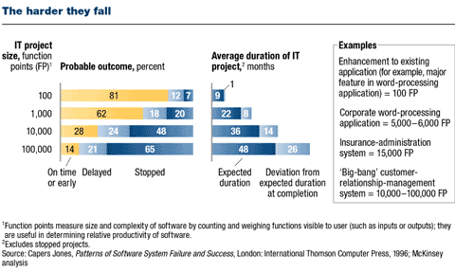
Implementations are complex large projects are more likely to fail
Source: McKinsey and Co

Slide 29
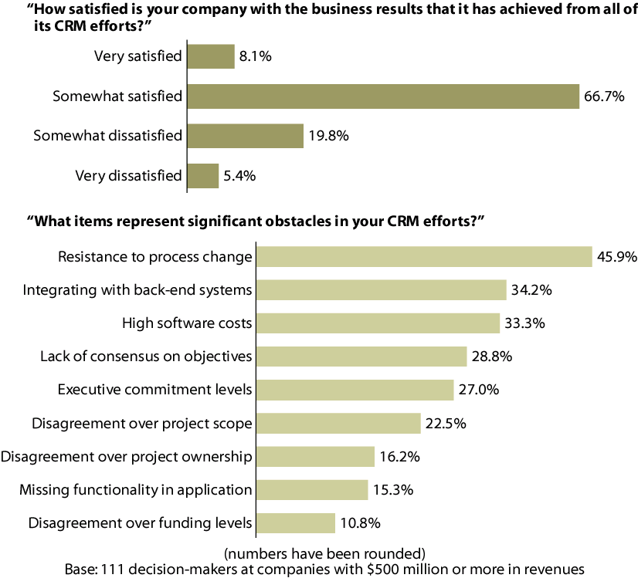
High satisfaction levels within the user base are rare
Source: Forrester Research

Slide 30
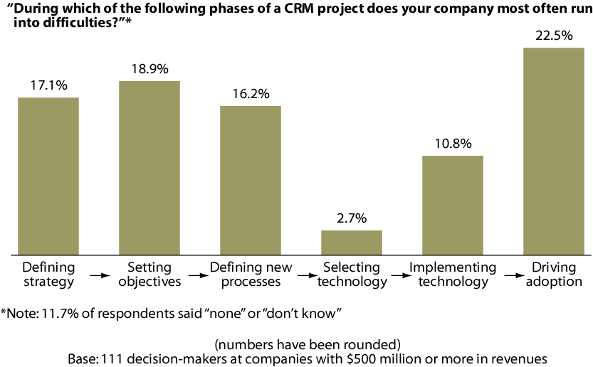
The greatest challenge is adoption within the company’s user base
Source: Forrester Research

Slide 31
Implementing CRM slowly by prototyping will improve adoption
Modular |  | Decompose the project into manageable modules to reduce scope-creep and risk Each module should be ‘self-contained’ and provide measurable benefits
Prototyping |  | Design demonstrations of modules to allow the business to gauge suitability and usability Use this feedback to iteratively improve the design Gain deep understanding of the CRM software constraints, thus minimising technical risks
Refinement |  | After each module is implemented, investigate how the software is being used in practice Use this feedback to refine existing modules and as input for design trade-offs for future modules
Source: SBI

Slide 32
Contents
Introduction to CRM
Approaches to CRM
Delivering a CRM Initiative
Selecting CRM Technology
Appendix

Slide 33
Build, or buy it from either functional or application suite software vendors?
Build-your-own |  | Design and build software in-house
Buy from functional software vendor |  | Purchase specific functional software (e.g. a Direct Mail application) Customise to company needs
Buy from application suite software vendor |  | Purchase software suite (e.g. Siebel, MS CRM) Implement relevant modules Customise to company needs

Slide 34
Companies are tending to favour the application suite software approach
Build-your-own |  | Pro - design to company’s exact specification Con - dependent on internal IT skills Con – can be difficult to scale (geography/functionality)
Buy from functional software vendor |  | Pro - can choose a best-of-breed application Con - limited breadth of functionality can mean that numerous applications need to be integrated to keep data synchronised
Buy from application suite software vendor |  | Pro - handles all functional areas (Sales, Marketing and Service) and Internationalisation Pro - vendor viability and number of implementations Con - price and customisation complexity Con - typically long implementation timescales

Slide 35
However, SME’s have specific needs from CRM software
Source: IDC

Slide 36
SME’s have specific needs from CRM software
Ease of Use
SME’s lack resource for complex training or expensive implementations
Customisation
SME’s may lack expertise in house so software needs to be configurable
Pre-built Integration
CRM needs to be integrated with other systems so pre-built “plug-ins” are important
Process Design
SME’s want CRM to fit their existing processes
Leading Technology
SME’s tend to buy established and not leading edge technology that is in line with other systems
Vertical Expertise
Importance is driven more by industry than company size. Companies in the distribution chain are more likely to rate vertical expertise as “highly important”
Source: IDC

Slide 37
How to chose the right product?
Value to SMEs is function of functionality, usability and integration features versus the cost of the solution. E.g. some products designed to be “based” on Lotus Notes or Outlook
Value to DECS
Mid Tier e.g. Saleslogix, e.piphany
High End e.g. SAP, Siebel
Low End e.g. Goldmine, Super Office
MS CRM
Minimum Value
V Low End e.g. ACT!,
Hosted e.g. salesforce.com
Cost
£100’s
Optimum Cost
£k’s
£m’s
Some potential examples…..Pivotal 5, Goldmine, SalesLogix, ACT!, e.piphany, salesforce.com, Leadtrack, Charter Continumn, Netsuite CRM, iExtensions (Lotus Notes), Goldvision (MS Outlook), Atlantic Global, SellIT (GEAC)

Slide 38
CRM solutions can delivered by a variety of packaged approaches
Product Type | Price Range | Functionality | Scalability | Strengths | Weaknesses
High-end & Custom Built Solutions | £50,000 – £250,000 + configuration = £400,000 – £1-5Ms** | High | High | Maximum functionality Technically robust | High cost Technology platform not aligned with SMEs Complex implementation
Low/Middle tier CRM Packaged Solutions | £150 – £1,000 per seat + configuration = £10,000 - £100sk** | High/Medium | High/Medium (can be restricted at the low end) | Lower initial cost Sufficient functions for SMEs Generally template driven (may have restricted options if not industry vertical) | Customisation can be difficult or costly Features vary widely
Hosted service | £600 a seat annually + usage charges (e.g. Salesforce.com) | High/Medium | Good | Fast time to launch No server or infrastructure required | Weak Integration Transaction charges No industry focus No customisation
SMEs “home grown” | Unknown (low) | Low – point solutions | Low | Good pilot/learning prototype | Not integrated Point solution
GEAC solution | Unknown (mid) | Limited/3rd party | Good | AS/400 Integration | May need GEAC Upgrade
**Configuration costs are dependent on extent of integration to back end systems

Slide 39
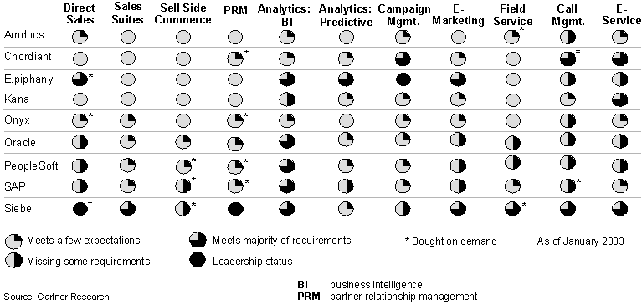
Siebel, Oracle, PeopleSoft and SAP are leaders for large organisations
But what about for SME’s?

Slide 40
Mid/Low Tier Packages’ roots = current strengths
MARKETING/PROMOTIONS
CAMPAIGNS
E.G. OUTBOUND
SERVICE MGT,
CALL CENTRE MANAGEMENT
Goldmine
Genesys, Client Logic
INTERNAL PROCESS MGT
E.G. SALES FORCE AUTOMATION
LEAD AND
CONTACT MANAGEMENT
E.G. INBOUND
GENERAL
INDUSTRY VERTICAL

Slide 41
Contents
Introduction to CRM
Approaches to CRM
Delivering a CRM Initiative
Selecting CRM Technology
Appendix

Slide 42
Appendix
Case Studies

Slide 43
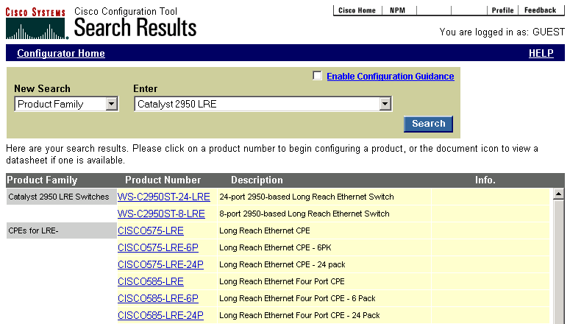
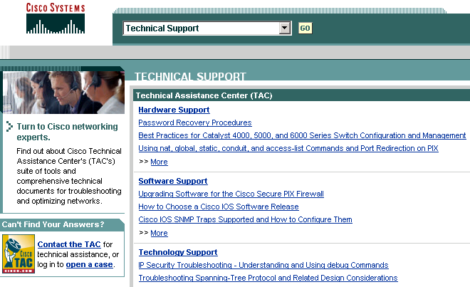
Cisco Systems
Business Challenge
Could not scale their human-based service to cope with demand
Complex products were difficult for customers to understand
Certain products compliment others but customer were not always aware of them
Solution
Online ordering and tracking from Cisco
Ability to locate partners and distributors
Configurators link complementary products
Online technical support and training materials
Results
Over 60% sales on-line ($5 billion online sales)
Saved $550M in operational costs
70% of inquiries shifted from call centres to Web

Slide 44
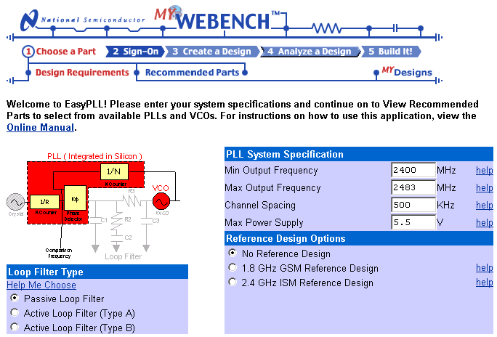
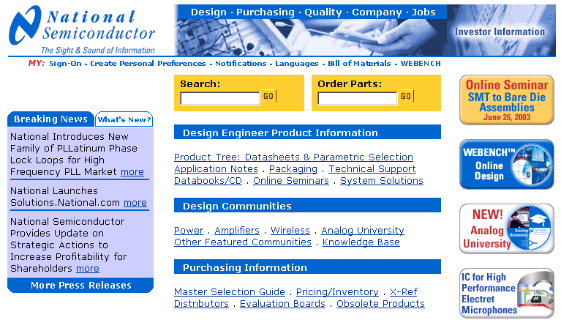
National Semiconductor
Business Challenge
Improve the design process for engineers
Simplify the ordering process for purchasing managers and support distributors
Solution
Application allows engineers to design circuits online, calculating specifications and cost
Simulation allows design to be tested virtually and a prototype to be ordered
Purchasing manager can order parts in bulk
Distributors receive bill of materials which covers both N.S. and other manufacturer parts
Results
1/3rd worlds design engineers visit every month
Saves an average of 43 hrs ($2580) per design
Mobile phone circuit revenue increased from $2 to $20 through cross-selling

Slide 45
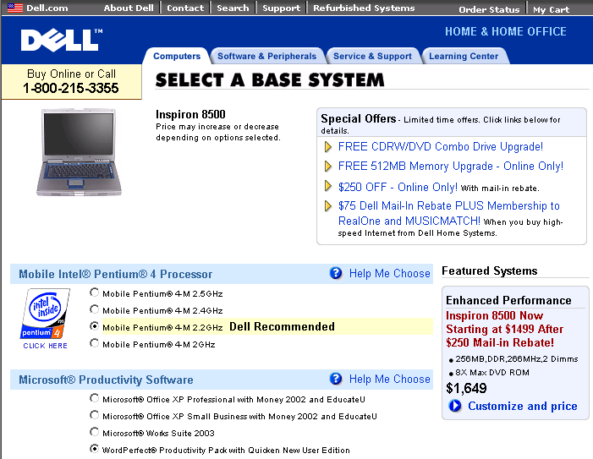
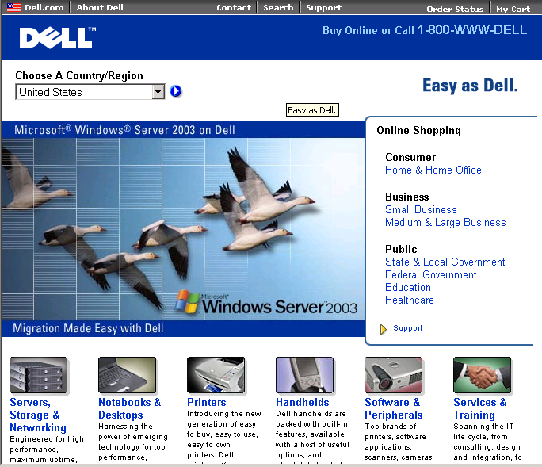
Dell
Business Challenge
Sell directly to customers (B2B & B2C)
Tailor products to customer specifications
Minimise stored and distressed inventory levels
Solution
Online confiuration, ordering, tracking and support for B2B and B2C customers
Personalised “Premier pages” site for key business accounts
Products are Built-to-Order to minimise inventory
Each machine has a unique ID to streamline technical support
Results
1.5 million customers visit web site per week
Online revenues $6 billion per year
More than 5,000 “Premier Pages” sites worldwide

Slide 46
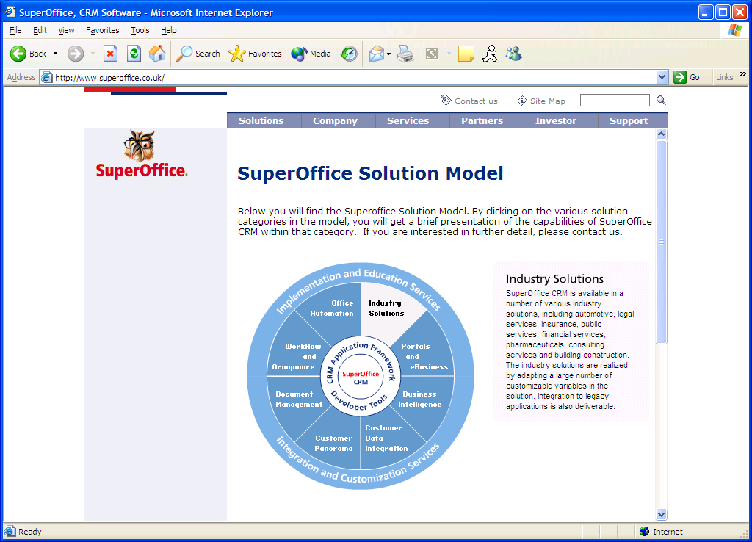
SuperOffice

